Slide 1
Chapter 7. Partial Differential Equations

Slide 2
SECOND-ORDER PARTIAL DIFFERENTIAL EQUATION
The three different classes of second-order quasi-linear equations are given geometric names:
Elliptic if B²-4AC < 0
Parabolic if B²-4AC = 0
Hyperbolic if B²-4AC > 0

Slide 3
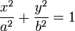
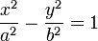
Standard forms by coordinate transformations
B²-4AC < 0
Ellipse:
Parabola:
Hyperbola:
B²-4AC = 0
B²-4AC > 0

Slide 4
PARTIAL DIFFERENTIAL EQUATIONS IN PHYSICS
Elliptic
(1) Laplace’s equation
Parabolic
(2) one-dimensional heat equation
Hyperbolic
(3) one-dimensional wave equation
One-dimensional refers to the fact that x denotes dimension, whereas t usually represent time.

Slide 5
The potential equation
Because A=C= 1, B = 0 therefore B²-4AC < 0 the equation is elliptic.
Laplace’s equation is encountered in problems dealing with potentials such as electrostatic, gravitational, and velocity potentials in fluid mechanics.
Also Poisson equation

Slide 6
The heat equation
Also called the
diffusion equation
Because equation has A= 1, B =C= 0 therefore B²-4AC = 0 the equation is parabolic.
This equation occurs in the theory of heat flow (that is, heat transferred by conduction) in a rod or thin wire.
Function u(x, t): temperature in the rod.

Slide 7
The wave equation (Vibrating string etc)
Because A= 1, B = 0, C = -1/a² therefore B²-4AC > 0 the equation is hyperbolic.

Slide 8
Elliptic Equations: Finite Difference
Solution Technique
Elliptic equations in engineering are typically used to characterize steady-state, boundary value problems.
For numerical solution of elliptic PDEs, the PDE is transformed into an algebraic difference equation.

Slide 9
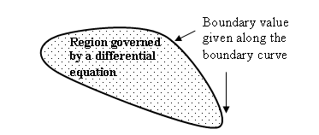
Boundary value problem
-Dirichlet B.C.: Specify u(x,y,...) on boundaries (say at x=0, x=L_{x}, y=0, y=L_{y} in a rectangular box)
-von Neumann B.C.: Specify normal gradient of u(x,y,...) on boundaries.
In principle boundary can be arbitrary shaped.

Slide 10
Boundary value problem

Slide 11
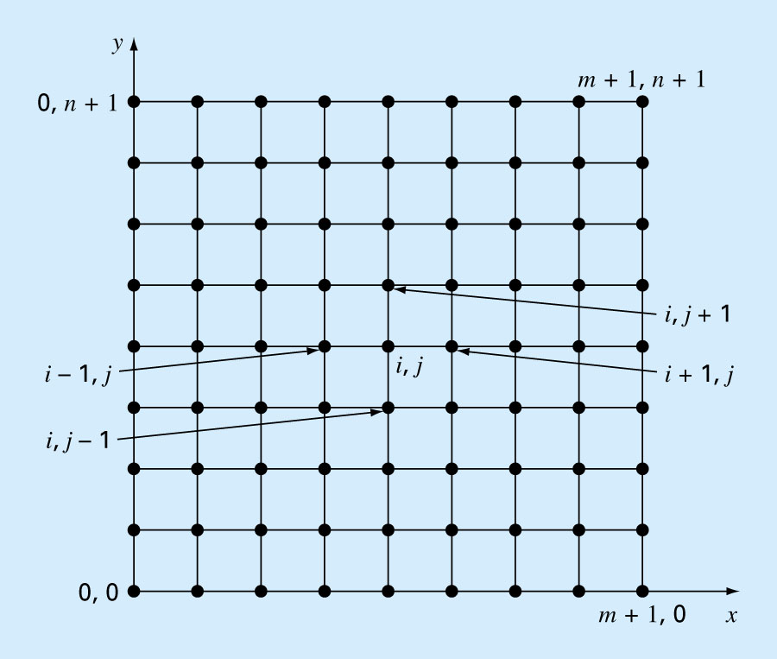
2D heated plate (temperature T does not change with t)

Slide 12
The Laplacian Difference Equations
Laplace Equation
O[Δ(x)²]
O[Δ(y)²]
Laplacian difference equation.
Holds for all interior points

Slide 13
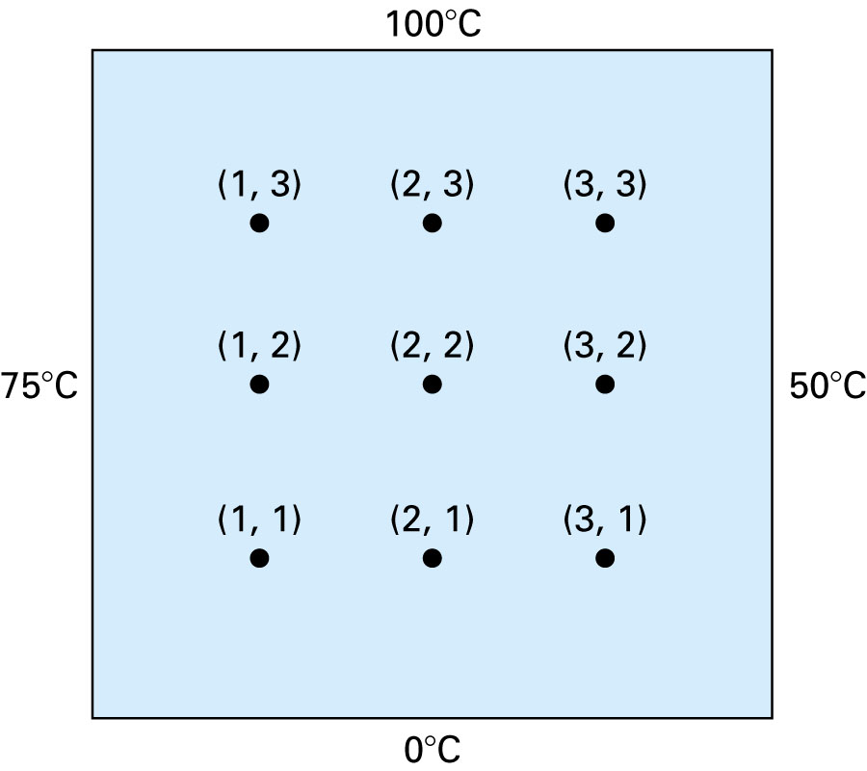

Slide 14
In addition, boundary conditions along the edges must be specified to obtain a unique solution.
The simplest case is where the temperature at the boundary is set at a fixed value, Dirichlet boundary condition.
A balance for node (1,1) is:
Similar equations can be developed for other interior points to result in a set of simultaneous equations.

Slide 15
The result is a set of nine simultaneous equations with nine unknowns:

Slide 16
Derivative Boundary Conditions
Some problems involve boundaries at which the derivative is specified and boundaries that are irregularly shaped.
Known as a Neumann boundary condition.
For the heated plate problem, heat flux is specified at the boundary, rather than the temperature.
If the edge is insulated, this derivative becomes zero.

Slide 17
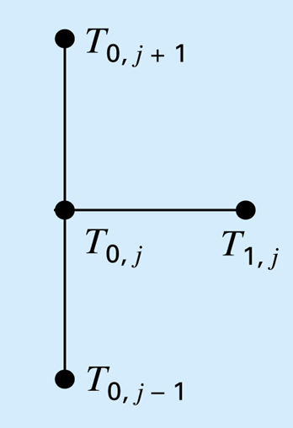
Method-I

Slide 18
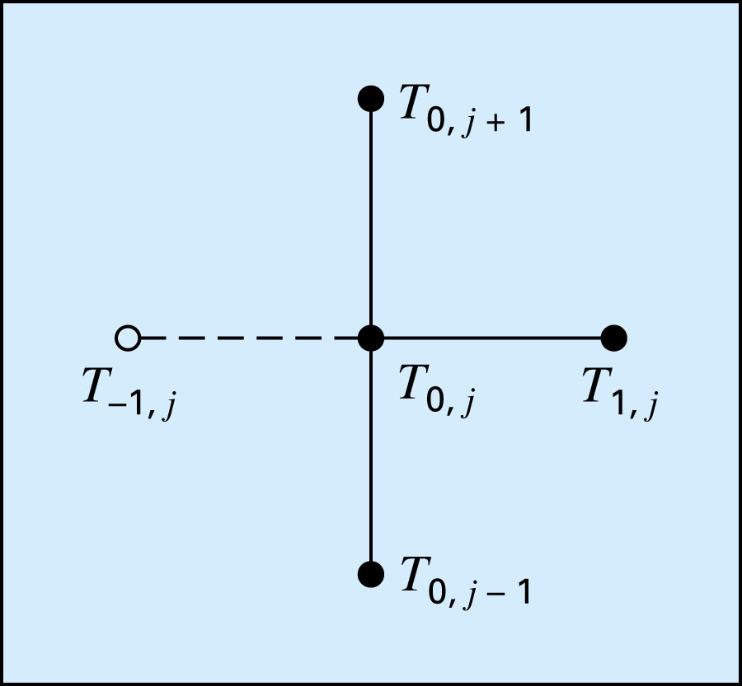
Method-II
ghost point

Slide 19
Thus, the derivative has been incorporated into the balance.
Similar relationships can be developed for derivative boundary conditions at the other edges.

Slide 20
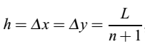
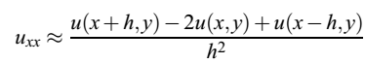
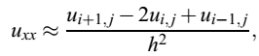
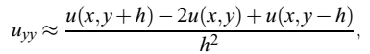
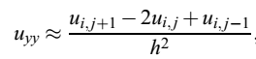
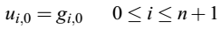
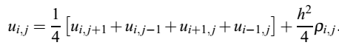
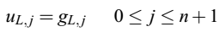
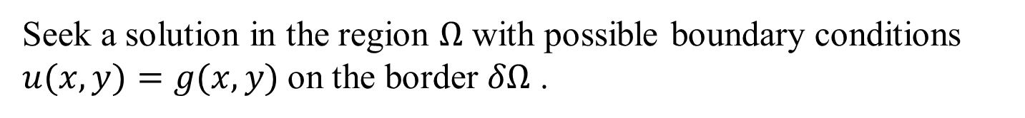


Poisson’s Equations
Seek a solution in the region $Ω$ with possible boundary conditions $u(x, y)=g(x, y)$on the border $δΩ$ .
Choose the grid to be rectangular
$$⇒$$
$$⇒$$
The boundary conditions:

Slide 21
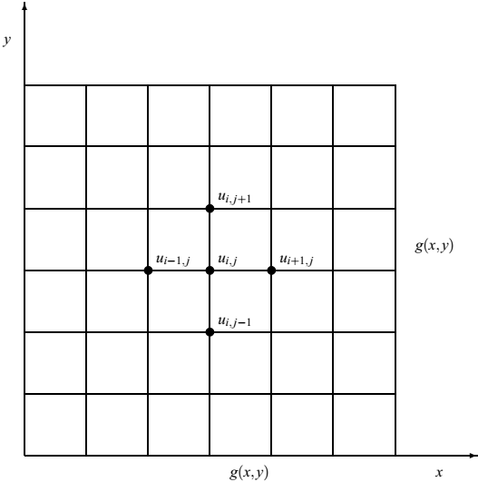
Five-point calculation method for the Laplace operator. The border δ Ω defines the boundary condition u(x, y) = g(x, y).

Slide 22
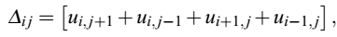
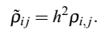
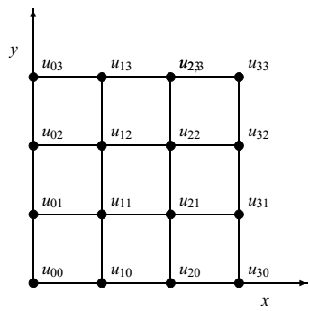
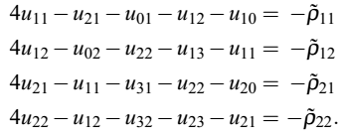
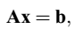
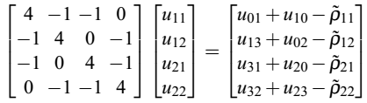
Scheme for solving Poisson’s equation
where
⇓
The matrix $A$ is rather sparse but is not on a tridiagonal form!

Slide 23
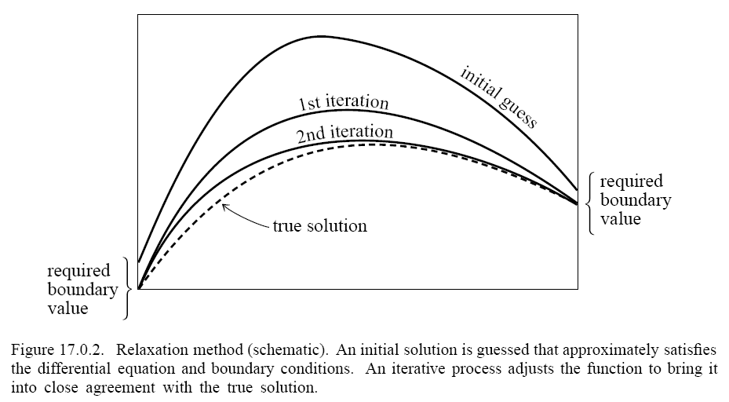
Iterative Method (Relaxation Methods)
Work with finite differences

Slide 24
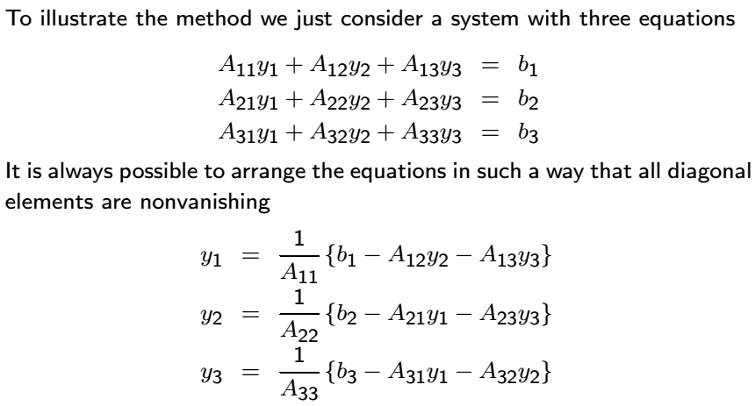
Iterative Method

Slide 25
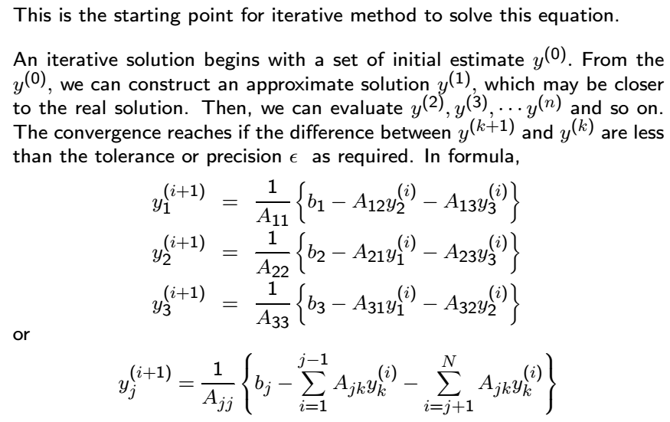
Jacobi’s algorithm

Slide 26
Matrix form of the Jacobi’s algorithm
Strict upper triangle
Diagonal
Strict lower triangle

Slide 27
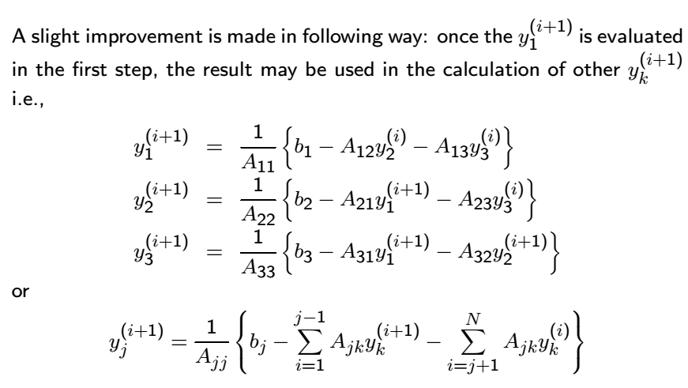
Gauss-Seidel algorithm

Slide 28
Matrix form of the Gauss-Seidel algorithm

Slide 29
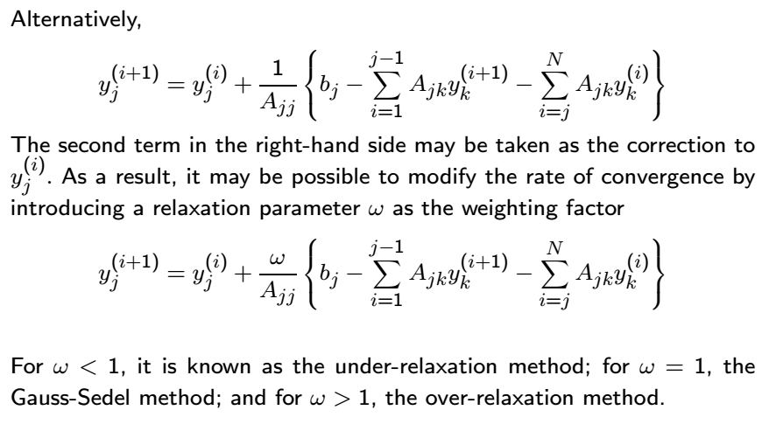
Gauss-Seidel algorithm

Slide 30
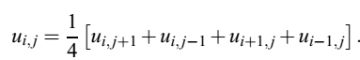
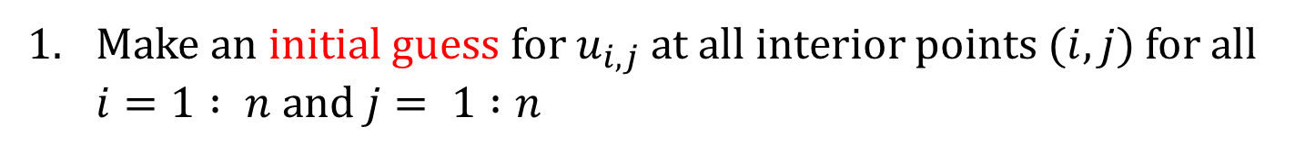
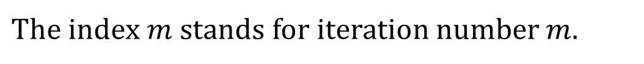
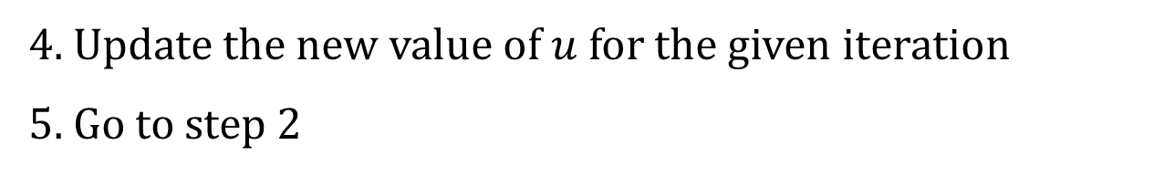
Jacobi’s Algorithm for solving Laplace’s Equation
Make an initial guess for $u_{i,j}$ at all interior points $(i, j)$for all $i=1 : n$ and $j= 1 :n$
2. Using the following Eq. to compute $u^{m}$
at all interior points (𝑖,𝑗).
$\text{The} \text{index} m$ stands for iteration number $m.$
3. Stop if prescribed convergence threshold is reached,
otherwise continue to the next step.
4. Update the new value of $u$ for the given iteration
5. Go to step 2

Slide 31
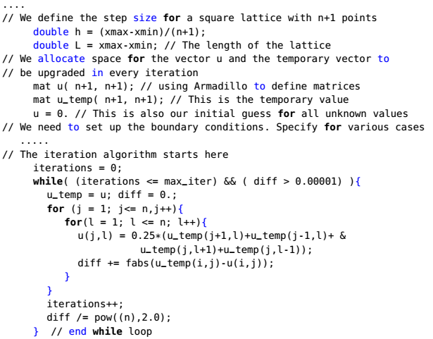
Jacobi’s Algorithm for solving Laplace’s Equation
Jacobi iteration scheme is very simple and parallelizable, but it has a slow convergence rate!

Slide 32
Jacobi’s VS. Gauss-Seidel Method
Jacobi’s algorithm:
Gauss-Seidel algorithm:
converge a little faster!

Slide 33
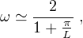
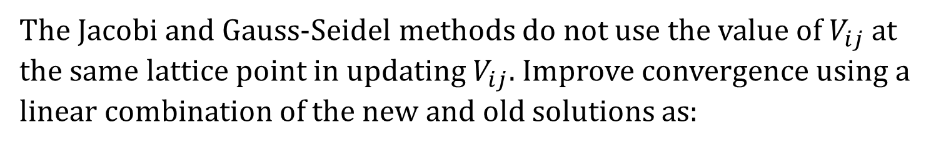
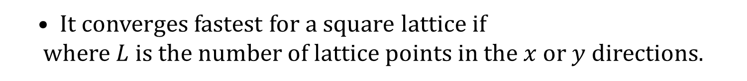
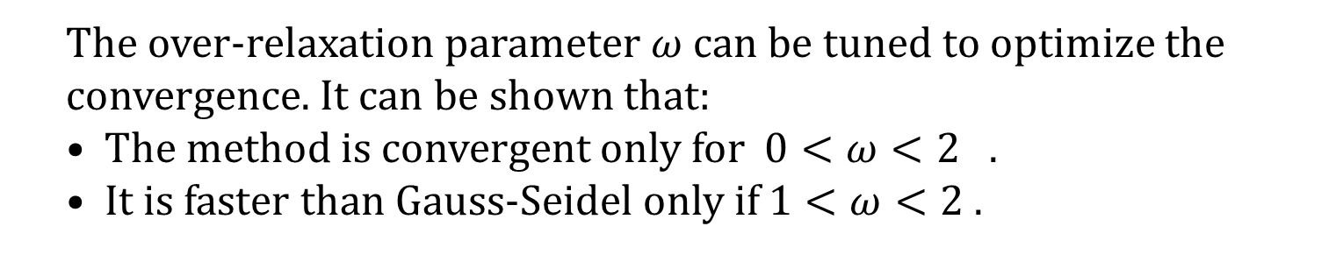
Successive Over Relaxation (SOR) method
The Jacobi and Gauss-Seidel methods do not use the value of $V_{ij}$ at the same lattice point in updating $V_{ij}$. Improve convergence using a linear combination of the new and old solutions as:
The over-relaxation parameter $ω$ can be tuned to optimize the convergence. It can be shown that:
The method is convergent only for $0<ω<2$ .
It is faster than Gauss-Seidel only if $1<ω<2$ .
It converges fastest for a square lattice if
where $L$ is the number of lattice points in the $x$or $y$ directions.

Slide 34
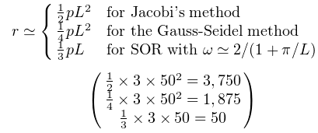
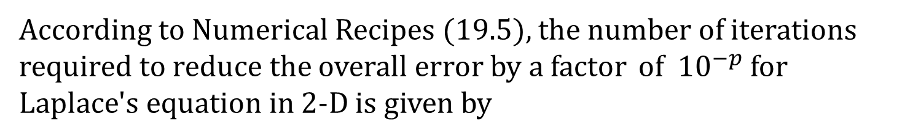
According to Numerical Recipes (19.5), the number of iterations required to reduce the overall error by a factor of ${10}^{−p}$for Laplace's equation in 2-D is given by

Slide 35
Convergence of Iterative Methods
Define the solution vector as
Define an error vector as
Substitute this into

Slide 36
Convergence of Iterative Methods
iteration
power
The iterative method will converge for any initial
iteration vector if the following condition is satisfied
Convergence condition

Slide 37
Norm of a vector
A vector norm should satisfy these conditions
Vector norms can be defined in different forms as long as the norm definition satisfies these conditions

Slide 38
Commonly used vector norms
Sum norm or ℓ₁ norm
Euclidean norm or ℓ₂ norm
Maximum norm or ℓ∞ norm

Slide 39
Norm of a matrix
A matrix norm should satisfy these conditions
Important identitiy

Slide 40
Commonly used matrix norms
Maximum column-sum norm or ℓ₁ norm
Spectral norm or ℓ₂ norm
Maximum row-sum norm or ℓ∞ norm

Slide 41
Example
Compute the ℓ₁ and ℓ∞ norms of the matrix
17
13
15
16
19
10

Slide 42
Convergence condition
Express E in terms of modal matrix P and Λ
Λ:Diagonal matrix with eigenvalues of E on the diagonal

Slide 43
Sufficient condition for convergence
If the magnitude of all eigenvalues of iteration matrix
E is less than 1 than the iteration is convergent
It is easier to compute the norm of a matrix than to compute its eigenvalues
is a sufficient condition for convergence

Slide 44
Convergence of Jacobi iteration
E=-D⁻¹(L+U)

Slide 45
Convergence of Jacobi iteration
Evaluate the infinity(maximum row sum) norm of E
Diagonally dominant matrix
If A is a diagonally dominant matrix, then Jacobi iteration converges for any initial vector

Slide 46
Stopping Criteria
Ax=b
At any iteration k, the residual term is
r^{k}=b-Ax^{k}
Check the norm of the residual term
||b-Ax^{k}||
If it is less than a threshold value stop

Slide 47
Example 1 (Jacobi Iteration)
Diagonally dominant matrix

Slide 48
Example 1 continued...
Matrix is diagonally dominant, Jacobi iterations are converging

Slide 49
Example 2
The matrix is not diagonally dominant

Slide 50
Example 2 continued...
The residual term is increasing at each iteration, so the iterations are diverging.
Note that the matrix is not diagonally dominant

Slide 51
Convergence of Gauss-Seidel iteration
GS iteration converges for any initial vector if A is a diagonally dominant matrix
GS iteration converges for any initial vector if A is a symmetric and positive definite matrix
Matrix A is positive definite if
x^{T}Ax>0 for every nonzero x vector

Slide 52
Positive Definite Matrices
A matrix is positive definite if all its eigenvalues are positive
A symmetric diagonally dominant matrix with positive diagonal entries is positive definite
If a matrix is positive definite
All the diagonal entries are positive
The largest (in magnitude) element of the whole matrix must lie on the diagonal

Slide 53
Positive Definitiness Check
Not positive definite
Largest element is not on the diagonal
Not positive definite
All diagonal entries are not positive
Positive definite
Symmetric, diagonally dominant, all diagonal entries are positive

Slide 54
Positive Definitiness Check
A decision can not be made just by investigating the matrix.
The matrix is diagonally dominant and all diagonal entries are positive but it is not symmetric.
To decide, check if all the eigenvalues are positive

Slide 55
Example (Gauss-Seidel Iteration)
Diagonally dominant matrix
Jacobi iteration

Slide 56
Example 1 continued...
Jacobi iteration
When both Jacobi and Gauss-Seidel iterations converge, Gauss-Seidel converges faster

Slide 57
Convergence of SOR method
If 0<ω<2, SOR method converges for any initial vector if A matrix is symmetric and positive definite
If ω>2, SOR method diverges
If 0<ω<1, SOR method converges but the convergence rate is slower (deceleration) than the Gauss-Seidel method.

Slide 58
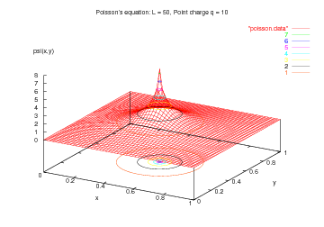
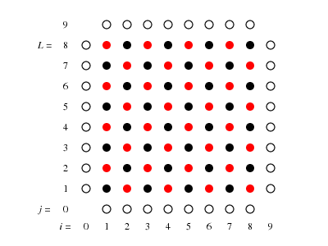
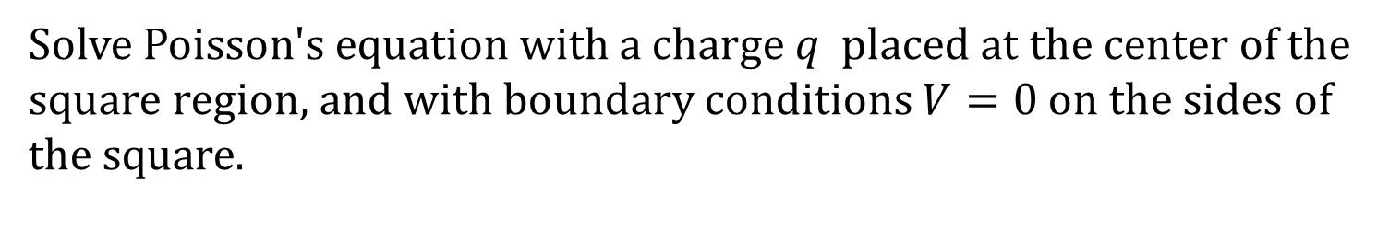
Example
Solve Poisson's equation with a charge$q$placed at the center of the
square region, and with boundary conditions $V=0$ on the sides of
the square.
possion.cpp

Slide 59
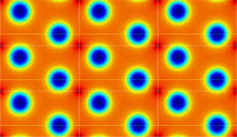
Question: How to solve Poisson equation with periodic boundary condition?
FFT
IFFT

Slide 60
How to solve quasi-linear PDE?
Finite difference: solve nonlinear equations

Slide 61
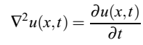
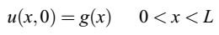
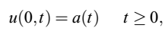
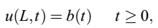
Parabolic Equations
Parabolic equations usually use a mixed set of conditions, namely an initial configuration combined with a boundary condition. As a concrete example, consider the diffusion equation,
with initial conditions, i.e., the conditions at $t=0$,
The boundary conditions are

Slide 62
Initial value problem
Boundary values are usually specified on all boundaries of the computational domain.
Initial conditions are specified in the entire computational (spatial) domain, but only for the initial time t=0.
Initial conditions as a Cauchy problem: -Specify initial distribution u(x,y,...,t=0) [for parabolic problems like the Heat equation] - Specify u and du/dt for t=0 [for hyperbolic problems like wave equation]

Slide 63
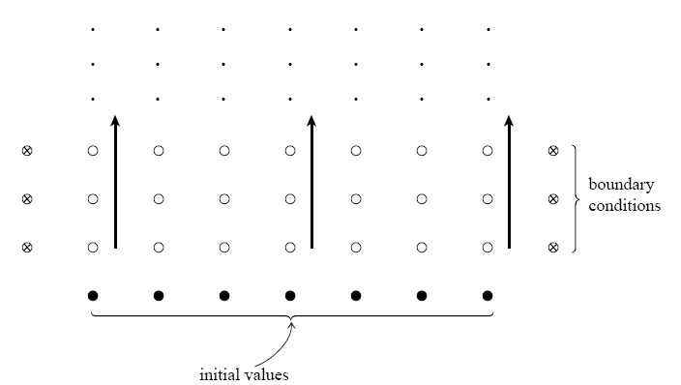
Initial value problem
t
t=0

Slide 64
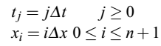
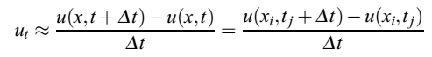







Explicit Scheme
Introduce different step lengths for the space-variable $x$ and time $t$ through the step length $∆x$ for $x$ and time step length $∆t$
The position after $i$ steps and time at time-step $j$ are given by
with a local approximation error $O(∆t)$
with a local approximation error $O(∆x2)$
⇒
⇒

Slide 65




Explicit Scheme
Defining results in the explicit scheme
Since all the discretized initial values are known, after one time-step the only unknown quantity is $u_{i,1},$which is given by

Slide 66


Explicit Scheme
Discretization of the integration area used in the solution of the $1+1−dimensional$diffusion equation.
Explicit numerical scheme for solving PDEs.

Slide 67
Example
Solve the 1D reaction-diffusion equation
D: Diffusion coefficient α: Reaction rate
Dirichlet boundary condition
Initial condition

Slide 68

M = 40 # GRID POINTS on space interval
N = 70 # GRID POINTS on time interval

Slide 69

M = 45 # GRID POINTS on space interval
N = 70 # GRID POINTS on time interval

Slide 70



Stability of the Numerical Scheme
It should be noted that these finite difference approximations are only valid to some order in $δx$ or $δt$.
convergent only when
Note that as the sizes$δx$ and $δt$are made smaller, the truncation error of approximating the partial derivatives by finite differences decreases. However, for smaller sizes, more computations need to be done to get solutions for the same domain and total time, which leads to increased roundoff error. The total error as a function of these sizes is sketched in the figure.

Slide 71












Explicit Scheme for Solving
Initial conditions:
Boundary conditions:
⇒

Slide 72


Drawback of the explicit scheme
The explicit scheme is easy to implement, but has weak stability
⇓
$spectral radius ρ\left(\hat{A}\right)$ < 1
Spectral radius of a matrix
The iterative process converges if the spectral radius of T is below 1, where spectral radius of a matrix is defined as:
The largest eigenvalue (the first after ordering) governs the dynamic system, i.e.:

Slide 73
Alternative way: Von Neumann stability analysis
Try
If
for any K, then the scheme is stable
If ,

Slide 74






Implicit Scheme for Solving
backward Euler
$$u_{i,j−1}=−αu_{i−1,j}+\left(1+2α\right)u_{i,j}−αu_{i+1,j}$$

Slide 75
Stability of the implicit scheme
The implicit scheme is stable for all combinations of $∆t and ∆x.$
Von Neumann stability analysis
$$u_{i,j−1}=−αu_{i−1,j}+\left(1+2α\right)u_{i,j}−αu_{i+1,j}$$
Implicit method is unconditional stable. No restrictions on timestep.

Slide 76




Slide 77


Implicit Scheme
Discretization of the integration area used in the solution of the $1+1−dimensional$diffusion equation.
Implicit numerical scheme for solving PDEs.

Slide 78

M = 45 # GRID POINTS on space interval
N = 70 # GRID POINTS on time interval

Slide 79



Crank-Nicolson Scheme for Solving
Implicit Scheme: local approximation error $O(∆t)$
Forward explicit scheme
Backward implicit scheme
Crank and Nicolson scheme
Crank-Nicolson scheme can be rewritten
stable for all combinations of $∆t and ∆x.$

Slide 80


Crank-Nicolson Scheme
Crank-Nicolson numerical scheme for solving PDEs.

Slide 81

Comparison of truncation errors for BTCS and Crank-Nicolson schemes as a function of Δt for fixed Δx.

Slide 82

Time Stepping Methods
Explicit Scheme
Implicit Scheme
Crank-Nicolson Scheme

Slide 83


Slide 84
Solve time-dependent Schrödinger equation
Crank-Nicolson Scheme
Discretize x, and denote x_{j}=jΔx (j=1,⋯,L) and ψ(x_{j})=ψ_{j}
Discretize the time and denote ψ(t_{n})=ψ(nΔt)=ψ^{n}.
inverse of a tridiagonal matrix

Slide 85
A STABLE EXPLICIT SCHEME
J. Chem. Phys. 68, 2794 (1978)
Also efficient for 2D and 3D Schrödinger equation

Slide 86







Diffusion Equation in Two Dimensions
$$⇒$$

Slide 87




Wave Equation in 1+1 dimension (Hyperbolic)
⇓
Explicit scheme

Slide 88



Wave Equation: 1+1 dimension
the initial condition
⇒
for the first time step

Slide 89
Stability of the explicit scheme
Von Neumann stability analysis
If , the explicit scheme is stable

Slide 90







Wave Equation: 2+1 dimension
Finite difference
⇓

Slide 91

Method: Separation of variables

Slide 92


Slide 93



Slide 94


Slide 95




https://chem.libretexts.org/Textbook_Maps/Physical_and_Theoretical_Chemistry_Textbook_Maps/Map%3A_Physical_Chemistry_(McQuarrie_and_Simon)/02._The_Classical_Wave_Equation/2.5%3A_A_Vibrating_Membrane
https://demonstrations.wolfram.com/VibrationOfARectangularMembrane/

Slide 96

Finite-difference method for solving Maxwell's equations
Constitutive relations
Finite-Difference Time-Domain Method by Kane S. Yee (美籍华人)
https://uspas.fnal.gov/materials/10MIT/FDTD_Basics.pdf
Yee cell

Slide 97




Finite element method (FEM)
Divide into
smaller pieces
Element
Node
Obtain full solution
Obtain solutions at nodes
Perform calculations
elementwise

Slide 98
Homework
1. Consider the Poisson equation
∇²φ(x, y) = −ρ(x, y)/ɛ₀
from electrostatics on a rectangular geometry with x ∈ [0, L_{x} ] and y ∈[0, L_{y} ]. Write a program that solves this equation using the relaxation
method. Test your program with:
ρ(x, y) = 0, φ(0, y) = φ(L_{x} , y) =φ(x, 0) = 0, φ(x, L_{y} ) = 1V, L_{x} = 1m, and L_{y} = 1.5m;
ρ(x, y)/ɛ₀ = 1 V/m²,
φ(0, y) = φ(L_{x} , y) = φ(x, 0) = φ(x, L_{y} ) = 0,
and L_{x} = L_{y} = 1 m.

Slide 99

2. Solve the time-dependent Schrodinger equation using both the Crank–Nicolson scheme and stable explicit scheme. Consider the one-dimensional case and test it by applying it to the problem of a square well with a Gaussian initial state coming in from the left.
Hint: Gaussian initial state

Slide 100
3. Prove the stability condition of the explicit scheme of the 1D wave equation by performing Von Neumann stability analysis
If , the explicit scheme is stable

